Slide 1
Update on Compounding Pharmacy Engineering Controls and
Proposed USP Chapter <800>
on Hazardous Drugs
Bill Peters
NuAire, Inc.

Slide 2
Compounding Regulators
Safe Compounding Act of 2013
  Gives FDA authority for compounding
    Over 80 483s and warning letters issued to what will be considered FDA outsourcing facilities
  503A
    Traditional compounders (prescription based) falling under their respective state pharmacy board
  503B
    FDA Registered outsourcing facilities
Notes:
This guidance announces FDA’s intention with regard to enforcement of section 503A of the Federal Food, Drug, and Cosmetic Act (the FD&C Act) (21 U.S.C. 353a) to regulate entities that compound drugs, now that section 503A has been amended by Congress to remove the advertising and solicitation provisions that were struck down as unconstitutional by the U.S. Supreme Court in 2002 (see section II below). Several parts of section 503A require rulemaking and consultation with a Pharmacy Compounding Advisory Committee to implement. This guidance explains how those provisions will be applied pending those consultations and rulemaking. This guidance also describes some of the possible enforcement actions FDA may bring against individuals or firms that compound drugs in violation of the FD&C Act.
This guidance does not apply to registered outsourcing facilities under section 503B of the FD&C Act. Guidance for outsourcing facilities will be issued separately.

Slide 3
NABP and Individual State BOPs
National Association Boards of Pharmacy (NABP)
  Support State Boards of Pharmacy
    Aid in creation of certification regulations
    Provides Pharmacist Accreditation
  Not a regulatory body
Notes:
This guidance announces FDA’s intention with regard to enforcement of section 503A of the Federal Food, Drug, and Cosmetic Act (the FD&C Act) (21 U.S.C. 353a) to regulate entities that compound drugs, now that section 503A has been amended by Congress to remove the advertising and solicitation provisions that were struck down as unconstitutional by the U.S. Supreme Court in 2002 (see section II below). Several parts of section 503A require rulemaking and consultation with a Pharmacy Compounding Advisory Committee to implement. This guidance explains how those provisions will be applied pending those consultations and rulemaking. This guidance also describes some of the possible enforcement actions FDA may bring against individuals or firms that compound drugs in violation of the FD&C Act.
This guidance does not apply to registered outsourcing facilities under section 503B of the FD&C Act. Guidance for outsourcing facilities will be issued separately.

Slide 4
State Boards of Pharmacy (BOPs )
Each State BOP adopts their own regulations from USP all or in part
Each State provides their own inspection & enforcement
Know your State BOP regulations!
  http://www.clinicaliq.com/797-state-survey
For example in Texas for low and medium risk CSPs
  Allows use of CAI outside in ISO Class 7 room if meets the criteria in USP 797
  However, their rules interpretation requires an ISO Class 8 Ante-Area with hands free sink operation and full garb for all compounding regardless of meeting criteria for CAI use
Notes:
This guidance announces FDA’s intention with regard to enforcement of section 503A of the Federal Food, Drug, and Cosmetic Act (the FD&C Act) (21 U.S.C. 353a) to regulate entities that compound drugs, now that section 503A has been amended by Congress to remove the advertising and solicitation provisions that were struck down as unconstitutional by the U.S. Supreme Court in 2002 (see section II below). Several parts of section 503A require rulemaking and consultation with a Pharmacy Compounding Advisory Committee to implement. This guidance explains how those provisions will be applied pending those consultations and rulemaking. This guidance also describes some of the possible enforcement actions FDA may bring against individuals or firms that compound drugs in violation of the FD&C Act.
This guidance does not apply to registered outsourcing facilities under section 503B of the FD&C Act. Guidance for outsourcing facilities will be issued separately.

Slide 5
State Boards of Pharmacy (BOPs )
Inspector Training
  Critical Point Training
    Knowledge of Engineering Controls
    Knowledge and demonstration of “first air”
    Reference Certification Cards (see attachment)
Trend toward requiring CAG-003 and Accredited Certifiers
Notes:
This guidance announces FDA’s intention with regard to enforcement of section 503A of the Federal Food, Drug, and Cosmetic Act (the FD&C Act) (21 U.S.C. 353a) to regulate entities that compound drugs, now that section 503A has been amended by Congress to remove the advertising and solicitation provisions that were struck down as unconstitutional by the U.S. Supreme Court in 2002 (see section II below). Several parts of section 503A require rulemaking and consultation with a Pharmacy Compounding Advisory Committee to implement. This guidance explains how those provisions will be applied pending those consultations and rulemaking. This guidance also describes some of the possible enforcement actions FDA may bring against individuals or firms that compound drugs in violation of the FD&C Act.
This guidance does not apply to registered outsourcing facilities under section 503B of the FD&C Act. Guidance for outsourcing facilities will be issued separately.

Slide 6
Proposed USP Chapter <800>
Hazardous Drug Handling in Healthcare Settings
  Released for public comment March 28, 2014
  http://www.usp.org/usp-nf/notices/compounding-notice
Reference NIOSH Hazardous Drug Lists
  http://www.cdc.gov/niosh/topcis/hazardous

Slide 7
Proposed USP Chapter <800>
Facility requirements that differ from the current USP general chapter <797> include the following:
  1. Elimination of the low volume exemption
    All hazardous drug compounding shall be done in a separate area designated for hazardous drug compounding
  2. Allowance for a Containment Segregated Compounding Area (C-SCA)
    a separate, negative pressure room with at least 12 air changes per hour for use with compounding hazardous drugs
Note: The differences will be reconciled to a revised <797>
Note: <800> will be harmonized with the NIOSH alert
Notes:
Low- and medium risk hazardous drug CSP may be prepared in a BSC located in a C-SCA, provided the beyond-use date of the CSP does not exceed 12 hours. A CACI that meets the requirements in 797 may be used for hazardous drug compounding if it is placed in a C-SCA.

Slide 8
Proposed USP Chapter <800>
<800> will support sterile & non-sterile compounding
  <797>
  <795>

Slide 9
Proposed USP Chapter <800>
1. Introduction
2. List of Hazardous Drugs
3. Types of Exposure
4. Responsibilities of Personnel Handling Hazardous Drugs
5. Facility Design and Engineering Controls
6. Personal Protective Equipment
7. Hazard Communication Program
8. Training for Compounding Personnel
9. Receiving
10. Transporting

Slide 10
Proposed USP Chapter <800>
11. Dispensing HD Dosage Forms Not Requiring Alteration
12. Compounding HD Dosage Forms
13. Protection When Administering HDs
14. Cleaning: Deactivation, Decontamination, Cleaning, and Disinfection
15. Spill Control
16. Disposal
17. Environmental Quality and Control
18. Documentation
19. Medical Surveillance

Slide 11
Proposed USP Chapter <800>
Appendices
  a. Acronyms and Definitions
  b. Suggested Standard Operating Procedures (SOPs)
  c. Types of Biological Safety Cabinets (BSCs)
  d. Best Practices for Handling HDs
  e. Examples for Design of Hazardous Drug Compounding Areas
  f. Requirements for Personal Protective Equipment (PPE)

Slide 12
Proposed USP Chapter <800>
Selected Acronyms
  CETA Controlled Environment Testing Association
  CFR Code of Federal Regulations
  C-PEC Containment primary engineering control
  C-SCA Containment segregated compounding area
  C-SEC Containment secondary engineering control
  CSP Compounded sterile preparation
  CSTD Closed system drug-transfer device
  CVE Containment ventilated enclosure

Slide 13
Proposed USP Chapter <800>
Selected Definitions
  Containment Primary Engineering Control (C-PEC):
    A ventilated device designed and operated to minimize worker and environmental exposures to HDs by controlling emissions of airborne contaminants through the following:
    Containment Secondary Engineering Control (C-SEC): The C-SEC is the room in which the C-PEC is placed. It incorporates specific design and operational parameters required to contain the potential hazard within the compounding room, e.g., restricted access, barriers, special construction technique, ventilation, and room pressurization are components of the secondary control strategy.
Notes:
The full or partial enclosure of a potential contaminant source
The use of airflow capture velocities to capture and remove airborne contaminants near their point of generation
The use of air pressure relationships that define the direction of airflow into the cabinet
The use of HEPA filtration on all potentially contaminated exhaust streams
Examples of C-PECs include Class I, II, or III BSCs, CACIs, and CVE (e.g., powder hood).
C-PECs used for nonsterile compounding do not need to have ISO Class 5 air quality.
C-PECs used for sterile compounding shall have ISO Class 5 air quality (see Table 2).

Slide 14
Proposed USP Chapter <800>
Selected Definitions (continued)
  Containment Segregated Compounding Area (C-SCA): A type of C-SEC with nominal airflow and room pressurization requirements as they pertain to HD compounding. The C-SCA is limited for use with a BSC when preparing low- or medium-risk level CSPs with 12-hour or less BUDs, preparing CSPs in a CACI that meets the requirements in 797, or preparing of non-sterile HDs in a C-PEC.
  Containment Ventilated Enclosure (CVE): A full or partial enclosure that uses ventilation principles to capture, contain, and remove airborne contaminants (through HEPA filtration) and prevent their release into the work environment (see Table 2).

Slide 15
Proposed USP Chapter <800>
Selected Definitions (Continued)
  Supplemental Engineering Control:
  An adjunct control (e.g., CSTD) used in concurrence with primary and secondary control strategies. Supplemental engineering controls offer additional levels of protection and may facilitate enhanced occupational protection because the HD is handled outside of the protective controls of primary and secondary control environments (e.g., post-compounding transit, administration, and disposal).

Slide 16
Proposed USP Chapter <800>
Facility Design and Engineering Controls (5.0)
  Storage of HDs (5.2)
  Engineering Controls (5.3)
  Non-Sterile Compounding (5.4)
  Sterile Compounding (5.5)
  Combined: Non-Sterile and Sterile Compounding (5.6)
  Containment Supplemental Engineering controls (5.7)
    Closed System Transfer Devices (CSTDs)

Slide 17
Notes on Storage
(5.2 Storage of HDs)
“Unless the HDs already exist in their final unit dose or unit-of- use packaging, HDs shall be stored separately from other inventory in a manner to prevent contamination and personnel exposure, which includes storage in a negative pressure room with at least 12 air changes per hour (ACPH). Depending upon pharmacy design, HD storage within the HD buffer area can fulfill this storage criterion.”

Slide 18
Notes on
Secondary Engineering Controls
(5.2 Engineering Controls)
“HDs that require alteration shall be manipulated (mixed, diluted, compounded, and others) in a C-PEC in an area that is physically separated from other preparation areas, that is under negative pressure, and has at least 12 ACPH. Additional criteria are listed below.”
“minimum negative pressure of 0.01 inches of water column.”

Slide 19
Notes on
Non-Sterile HD Compounding
(5.4 Non-Sterile Compounding)
Table 3. Acceptable Configuration for
Non-sterile HD Compounding
FUNCTION | C-PEC | S-SEC | AIRFLOW | MAXIMUM BUD
Non-sterile compounding | Any C-PEC | C-SEC | 12 ACPH (exhaust) | As listed in <795>

Slide 20
Notes on BSC
(5.5 Sterile HD Compounding)
“Class II BSC, Types A2, B1, or B2 are all acceptable; however, for most known HDs, Type A2 cabinets offer a simple and reliable integration with the ventilation and pressurization requirements of the secondary engineering control. Class II Type B2 BSCs are typically reserved for use with highly volatile components.”

Slide 21
Notes on BSC
(5.5 Sterile HD Compounding)
Table 4. Acceptable Configuration for
Sterile-to-Sterile HD Compounding
CONFIGURATION | FUNCTION | C-PEC | C-SEC | AIRFLOW | MAXIMUM BUD
1 | Compounding sterile HD in a Cleanroom | BSC or CACI | ISO 7 Cleanroom | 30 ACPH (HEPA supply) | As listed in <797>
2 | Compounding sterile HD in a CACI that meets the requirements listed in <797> | CACI | C-SCA | 12 ACPH (exhaust) | As listed in <797>
3 | Compounding low or medium-risk sterile HDs in a BSC. [Note – This configuration is not acceptable for high-risk sterile HD compounding] | BSC | C-SCA | 12 ACPH (exhaust) | 12 hours

Slide 22
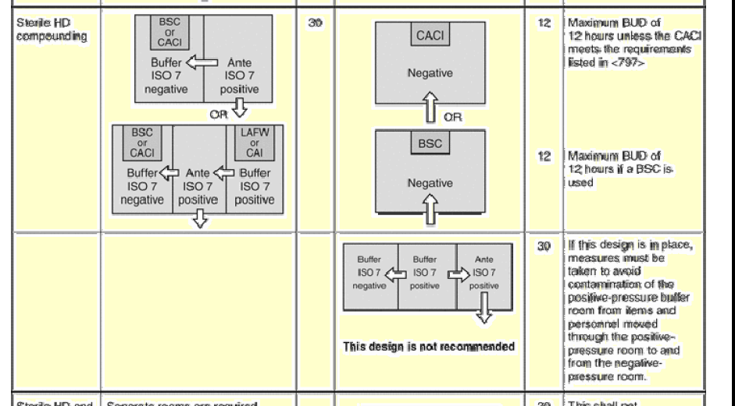
Proposed USP Chapter <800>
Appendix E: Examples for Design of
Hazardous Drug Compounding Areas

Slide 23
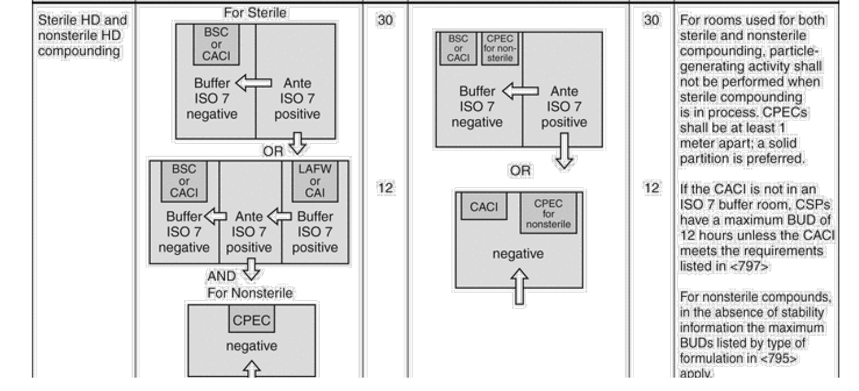
Proposed USP Chapter <800>
Appendix E: Examples for Design of
Hazardous Drug Compounding Areas

Slide 24


Acknowledgements
Jim Wagner

